Slide 1

Flight Price Prediction
By Rakesh chaudhary

Slide 2

Introduction:- Business Problem
Flight ticket prices can be something hard to guess, today we might see a price, check out the price of the same flight tomorrow, it will be a different story.
We might have often heard travelers saying that flight ticket prices are so unpredictable. Huh! Here we take on the challenge! As data scientists, we are gonna prove that given the right data anything can be predicted.

Slide 3
Abstract :-
The airline industry is considered as one of the most sophisticated industry in using complex pricing strategies. Nowadays, ticket prices can vary dynamically and significantly for the same flight, even for nearby seats. Anyone who has booked a flight ticket knows how unexpectedly the prices vary. The cheapest available ticket on a given flight gets more and less expensive over time. This usually happens as an attempt to maximize revenue based on
1. Time of purchase patterns (making sure last-minute purchases are expensive)
2. Keeping the flight as full as they want it (raising prices on a flight which is filling up in order to reduce sales and hold back inventory for those expensive last-minute expensive purchases)

Slide 4
Steps to Follow:-
Data Collection
Loading Dataset
Pre-Processing
Data Analysis
Data Cleaning
Scaling
Model Building
Hyper-Parameter Tuning
Conclusion

Slide 5





Data Collection:-
For this project, first of all we scrapped more than 3000 records from different sites. And then build a model for predicting the price of flight ticket. We have used “Selenium Web scrapping” tool for scrapping the data form online ticket booking sites. Some sites are mentioned below:-

Slide 6
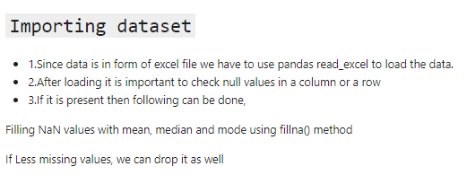
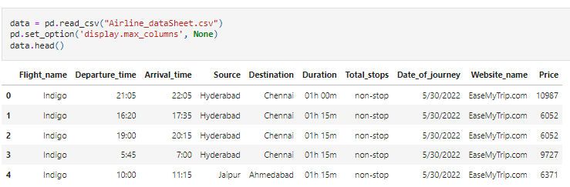
Loading the Dataset:-

Slide 7
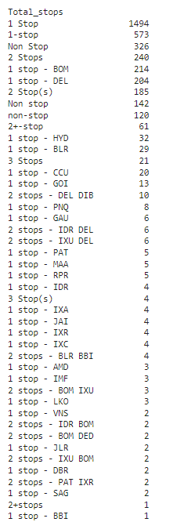
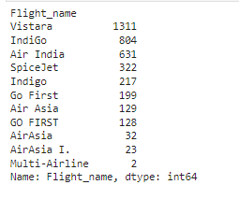
Data Pre-Processing:-
We see that in Airline name feature, Air Asia, AirAsia, AirAsia I. flights are different name of Air Asia flight. So we will convert them in one as Air Asia.
Also we see that Total stops feature are showing different name in similar stops . We have to handle them also.
Also we see that Total stops feature are showing different name in similar stops . We have to handle them also.

Slide 8


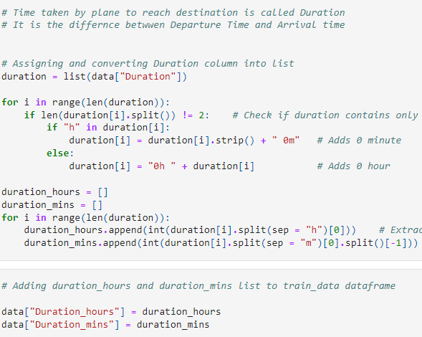
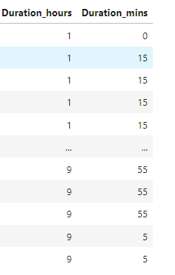
Data Pre-Processing:-
we will extract hours and minutes from duration feature and extract some meaning full information from it.
From description we can see that Date_of_Journey is a object data type,\ Therefore, we have to convert this datatype into timestamp so as to use this column properly for prediction
For this we require pandas to_datetime to convert object data type to date time dtype.
.dt.day method will extract only day of that date\ *.dt.month method will extract only month of that date
Before
Applying Code
After

Slide 9


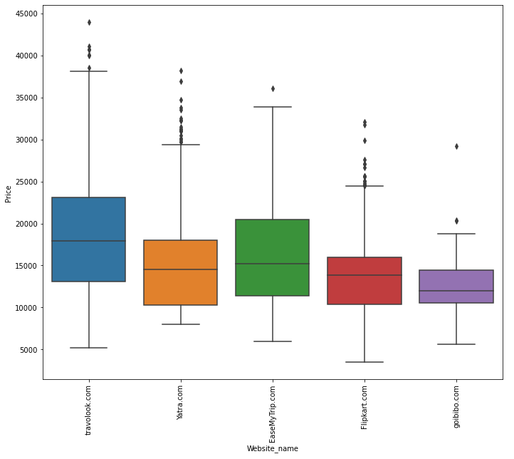
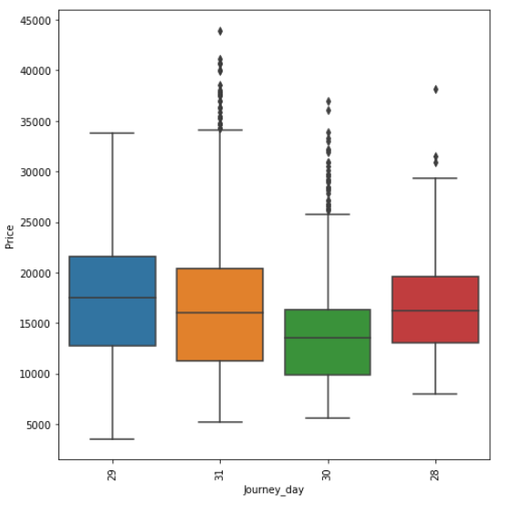
Data Analysis:-
travolook.com websites having highest price of domestic flights.
goibibo.com websites having least prices of domestic flights.
29th may and 31th may we can find the highest price of domestic flights.

Slide 10

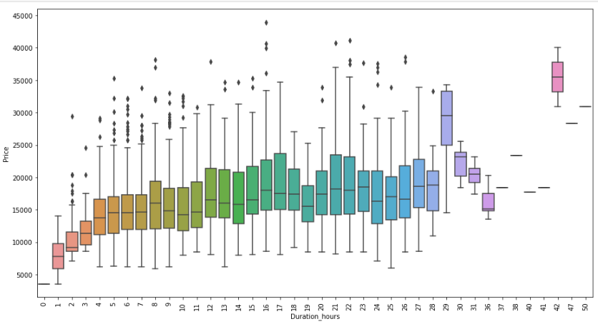
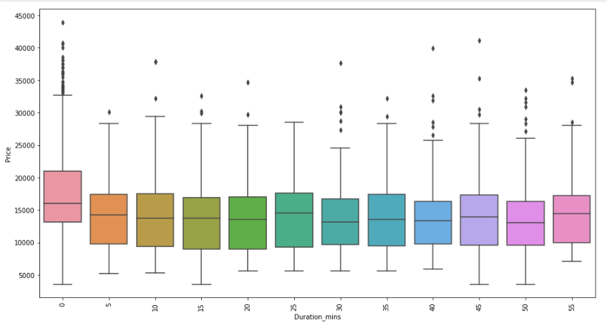
Data Analysis:-
As we can see that as number of duration hours increases the price are also increases. There are tight relation duration_hours and Price.
There are minimum relation between Duration_mins with price.

Slide 11


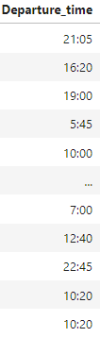
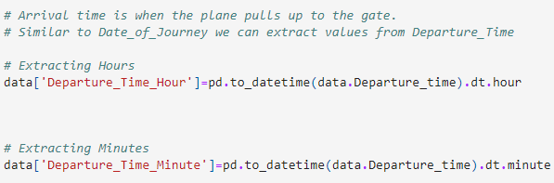

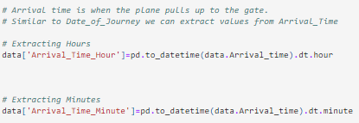
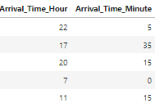
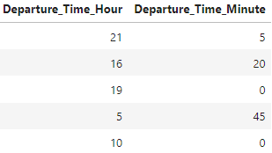
Data Analysis:-
let's extract some meaningful information from Arrival time feature:-

Slide 12
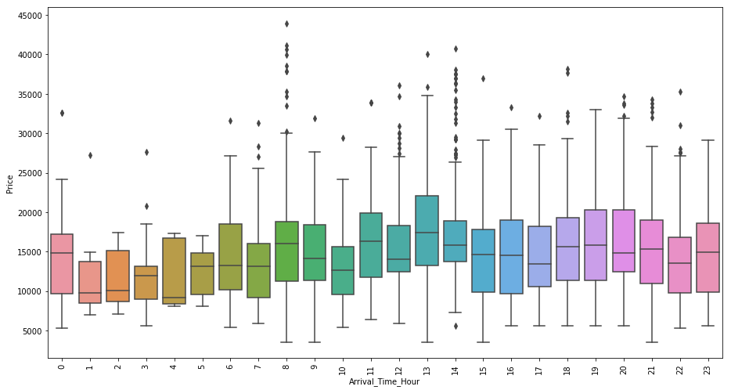
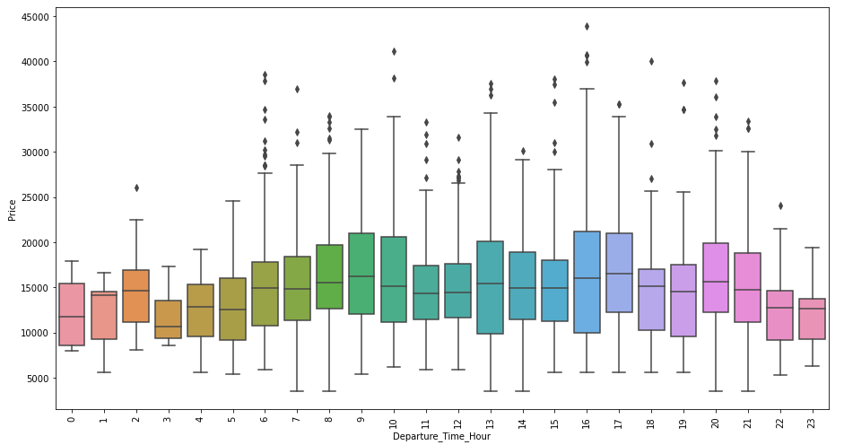
Data Analysis:-
There are uneven relation between Arrival_Time_hour and price.
There are also uneven relation between Departure_Time_hour and price.

Slide 13
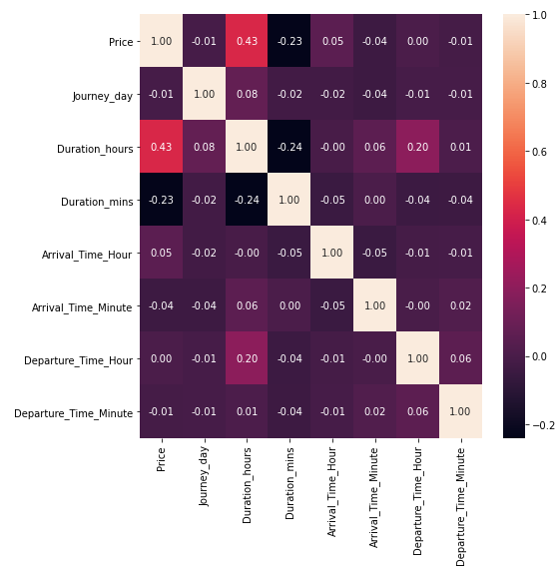
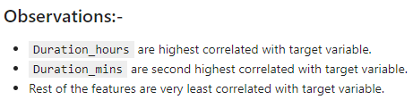
Data Analysis:- Heat-Map

Slide 14
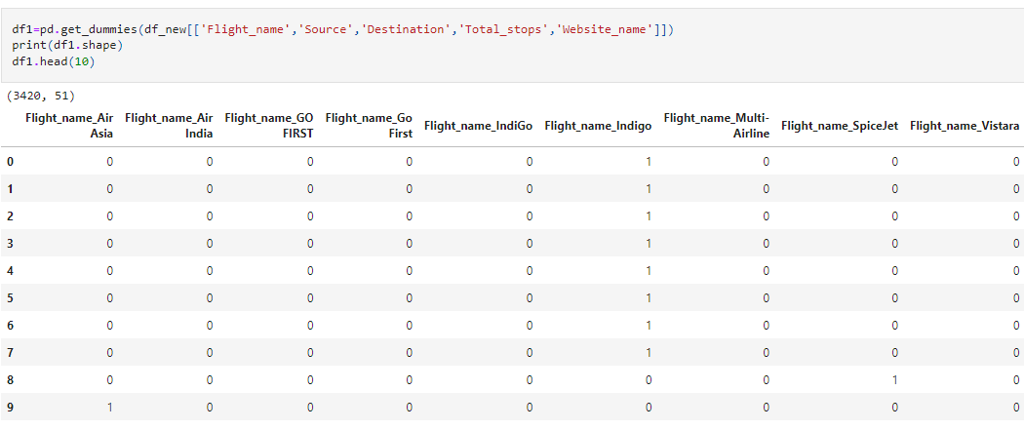
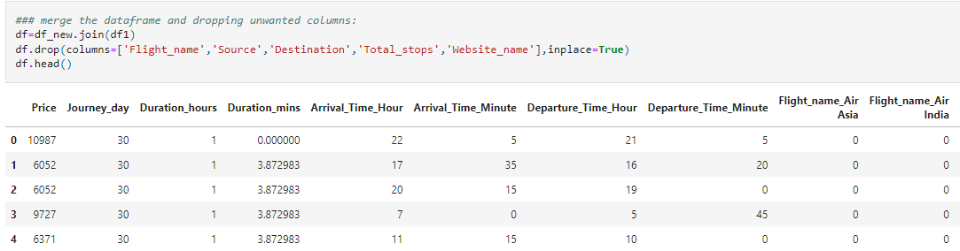
Encoding:-
As we know we have lots of categorical features, so we have to encode them by One Hot Encoding method

Slide 15
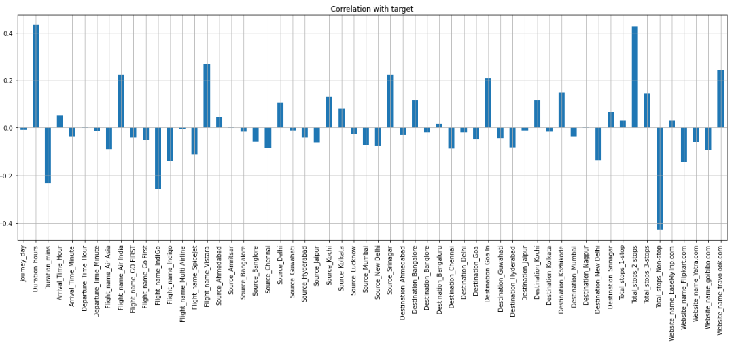
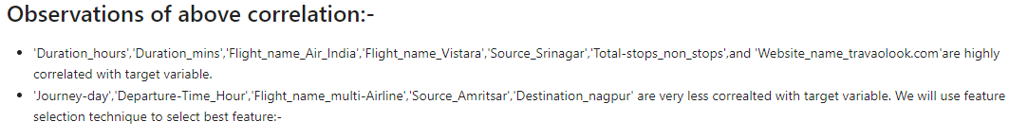
Data Analysis:- Correlation With Target

Slide 16
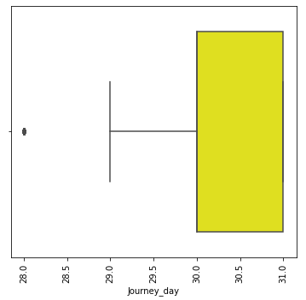
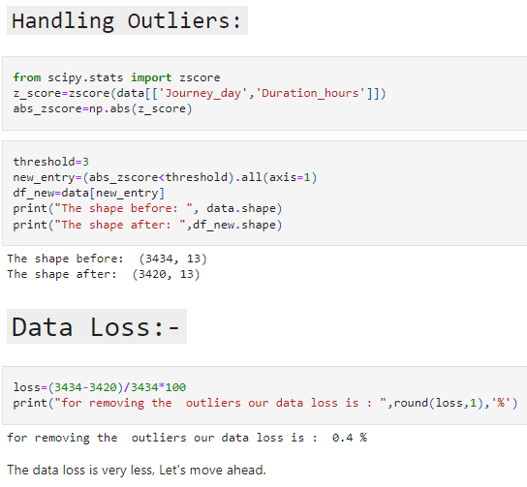
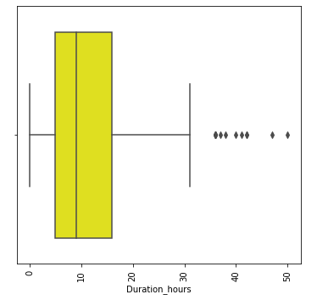
Data Cleaning:- Checking & Handling Outliers
Outliers

Slide 17
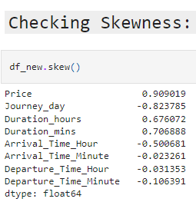
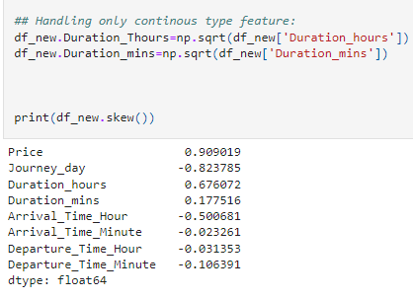
Data Cleaning:- Checking & Handling Skewness
Accepted Range for Skewness
Between -0.5 to +0.5

Slide 18
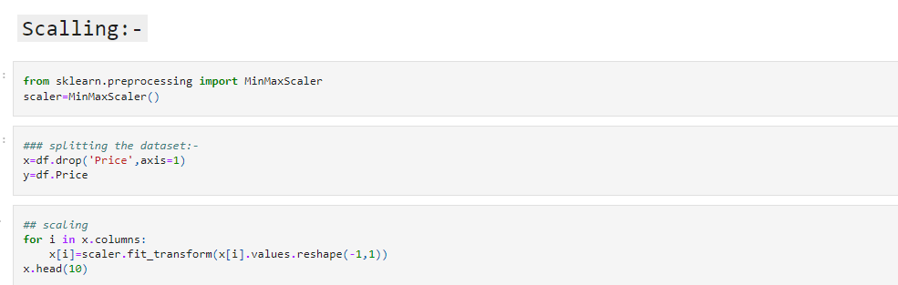
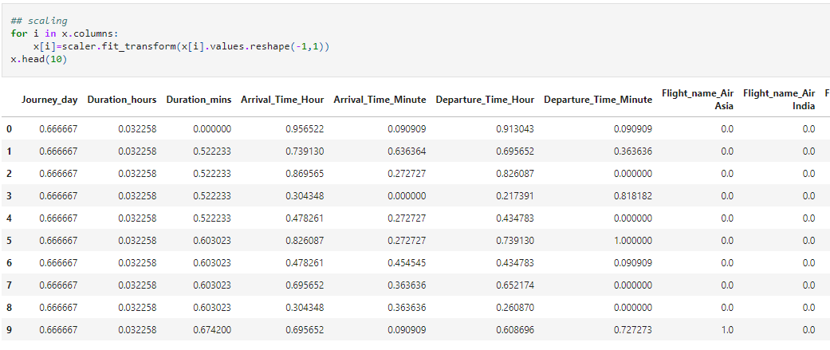
Data Scaling:-

Slide 19
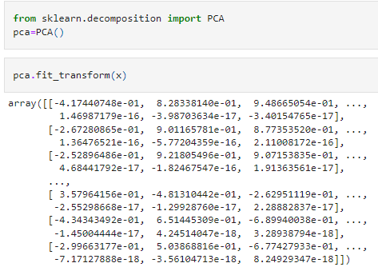
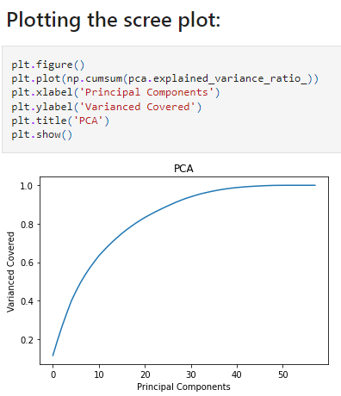
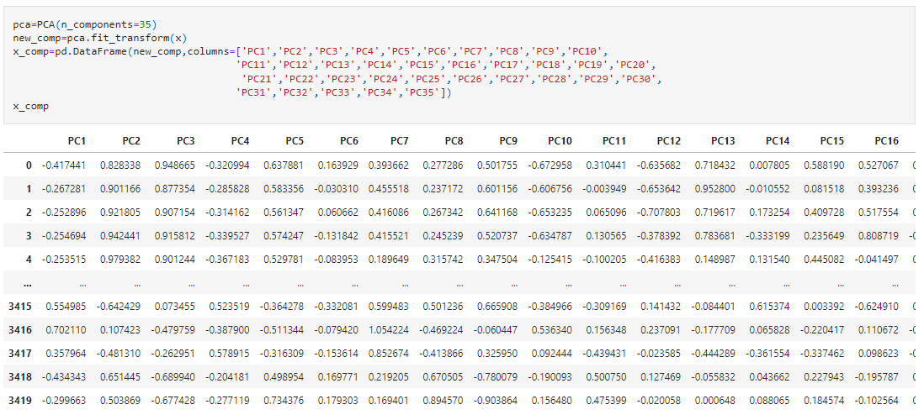
Data Scaling:- Using PCA
Step:- 1
Step:- 2
Step:- 3

Slide 20
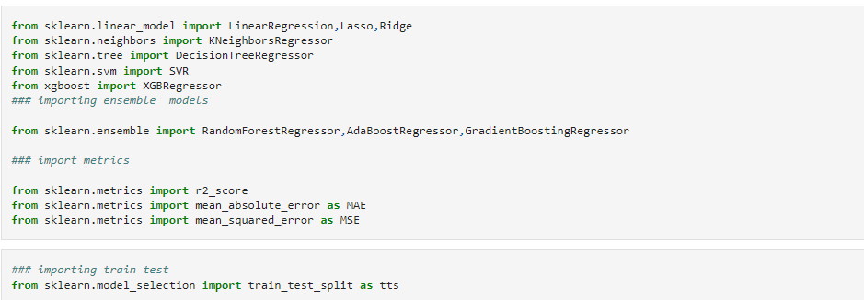
Model Building:-

Slide 21
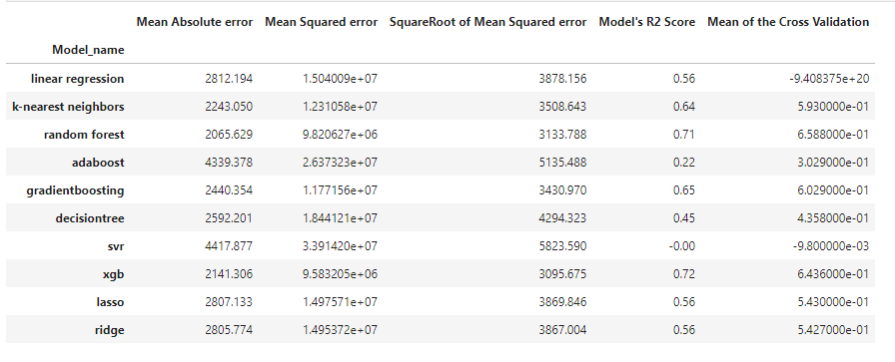
Model Building:- Printing Scores

Slide 22
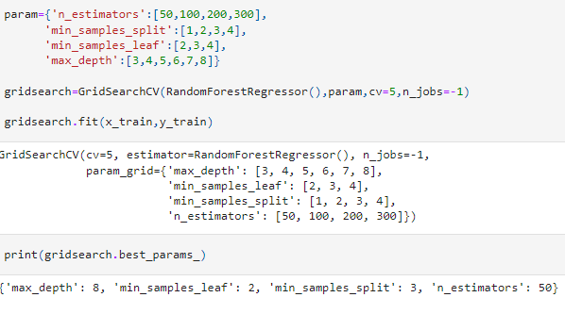
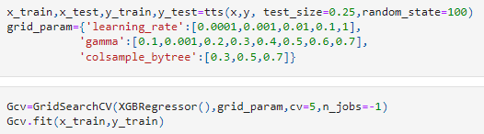

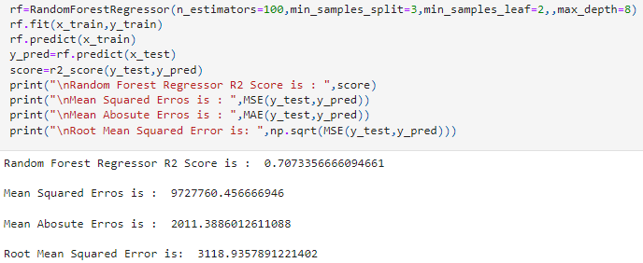
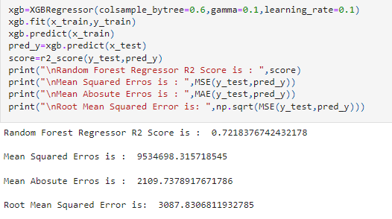
Hyper-Parameter Tuning:-
Random Forest Regressor
XGB Regressor

Slide 23
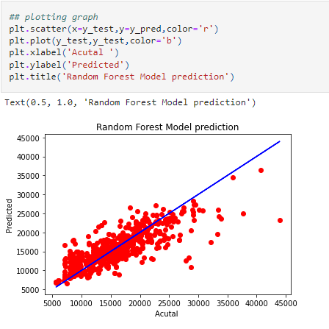
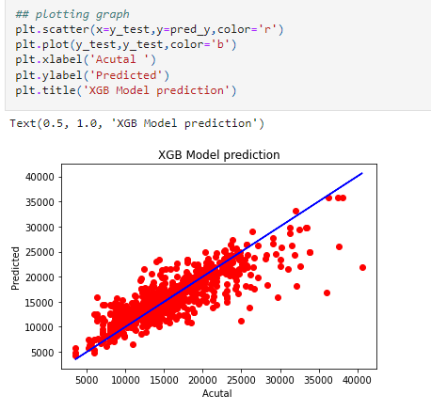
Model Evaluation:-
XGB Regressor
Random Forest Regressor
As we can see that XGB Gives us the Best Accuracy:

Slide 24
Conclusion:-
In this project we have scraped the flight data from airline webpages. Features like flight duration, number of stops during the journey and the departure and arrival time are playing major role in predicting the prices of the flights.
Visualization part helped me to understand the data as it provides graphical representation of huge data.
Assisted me to understand the feature importance, outliers or skewness detection and to compare the independent-dependent features.
Some algorithms are facing over-fitting problem which may be because of a smaller number of features in our dataset.
Limitation of the study is that in the volatile changing market we have taken the data, to be more precise we have taken the data at the time of pandemic and recent data, so when the pandemic ends the market correction might happen slowly.

